Slide 1

COMPANY PROFILE
STAR SMITH EXPORT PVT LTD
The Star Group was introduced in 1990 with Star Enterprises a vision to provide well engineered, high-quality products to the Indian market at an affordable price. Since then, there was no looking back and in 2006, Aerostar Enterprises Private Limited was born out of the continuous pursuit of perfection. Today, Aerostar is counted amongst the very few 'Make In India’ success stories in the home appliance industry.
After conducting extensive market research and study of technologies, we bring forth another unit by the name of STAR SMITH EXPORT PRIVATE LIMITED with wide range of Home Appliances and an exclusive class of Electric water heaters. We are the manufacturer and exporter of ISI marked and 5-star rated ceramic glass coated Tanks, Storage Water Heaters from 6 to 100 liters & Instant Water Heater.

Slide 2
COMPANY PROFILE
The water heaters are made according to the specifications required by the buyers. We have different kinds of models (round, square, vertical, horizontal (LHS/RHS/CP/Inlet-Outlet). Also, there are geysers that we can operate through a mobile app. We are having in house facilities for manufacturing all child parts of the glass coated Tank.
We believe in conducting business honestly and ethically and it’s been that way since 1990. We also believe in taking care of our customers, which is why we enjoy an outstanding reputation for excellence in all the markets we serve. Our Company motto is “Technology enables progress and knowledge with every innovation”

Slide 3
COMPANY TURNOVER
54 CRORE
CUSTOMERS
Inalsa
Ortem
Sujata
Lazer
Relaxo
North West
Faber
Zoom
Indcool
Luker
Hotstar
Thermoking
Metro
Champion
Oxaler
Servokon
Electron
G-tech
Notes:
,,,,,,,,,,,,,,,,.

Slide 4
PRODUCTION
CURRENT PRODCTION
SWH (STORAGE) - 500 Nos./DAY
IWH (INSTANT) - 400 Nos./DAY
PRODUCTION CAPACITY
SWH (STORAGE) - 2500 Nos./DAY
IWH (INSTANT) - 1000 Nos./DAY

Slide 5
COMPANY AREA & LAYOUT
AREA- 1800 SQ.MTR.
5 FLOORS
BASEMENT-FABRICATION, TOOL ROOM
GROUND FLOOR- MOLDING, COATING FURNANCE, IQC
FIRST FLOOR – LAB & TANK STORE AREA
SECOND FLOOR- ASSEMBLY LINE & FG
THIRD FLOOR- STORE(RM,CARTON,THERMOCOL)
FOURTH FLOOR- PAINT SHOP & CRC BODY FABRICATION

Slide 6
ORGANISATION STRUCTURE
Mr. Hitesh Goyal
Managing Director
Mr. Devesh Goyal
Managing Director
Mr. Meenu Goyal
Managing Director
PURCHASE
Plant Head
Quality Head
SALES
HR &
ACCOUNTS
TOOL
ROOM
ASSY.
PRODUTION
IQC
PDI &
LAB
PQC
GEYSER
NPD
STORE &
DISPATCH
PURCHASE &
PPC
PQC
FABRICATION
PQC
PAINT SHOP
Total Management Staff – 19

Slide 7
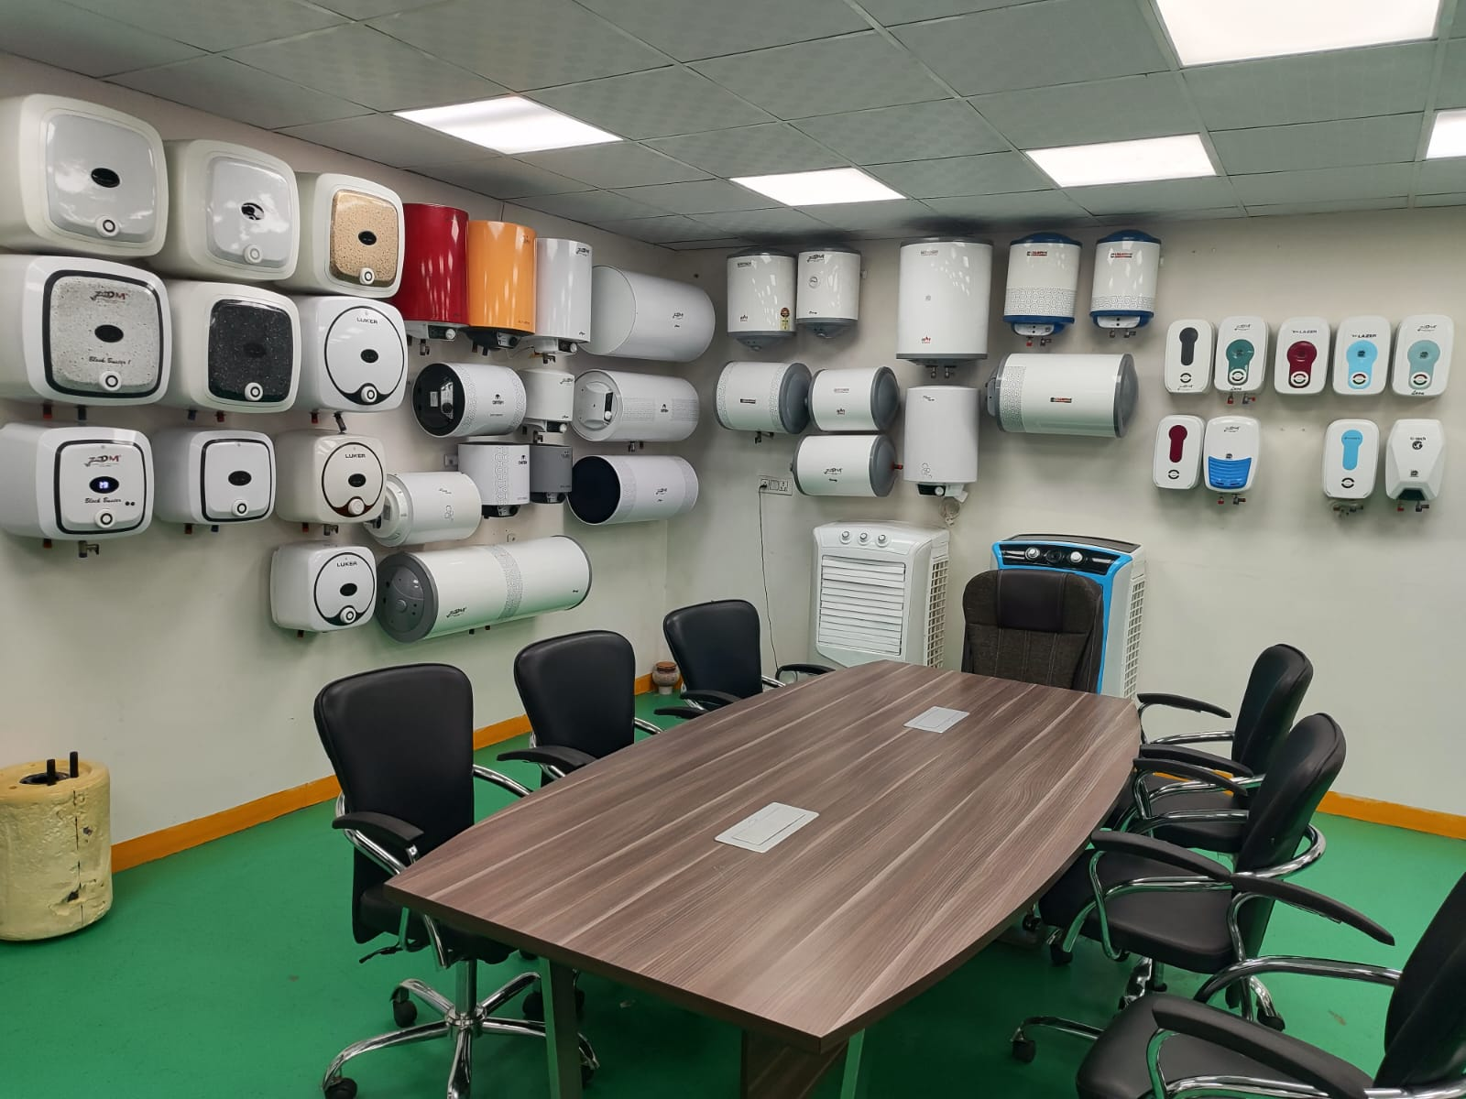
COMPANY LAYOUT
CONFERENCE ROOM

Slide 8
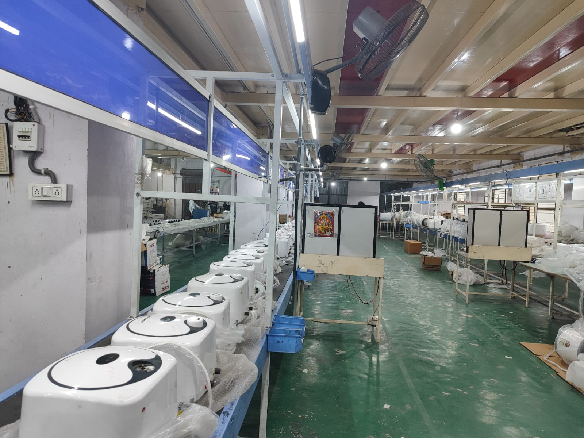
COMPANY LAYOUT
GEYSER ASSEMBLY LINE

Slide 9
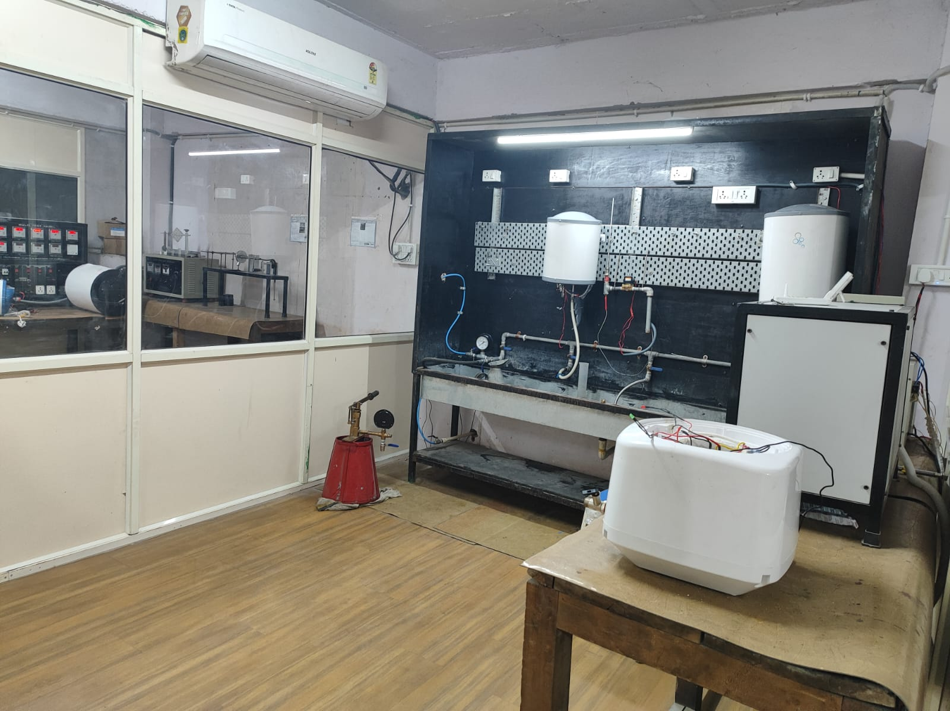
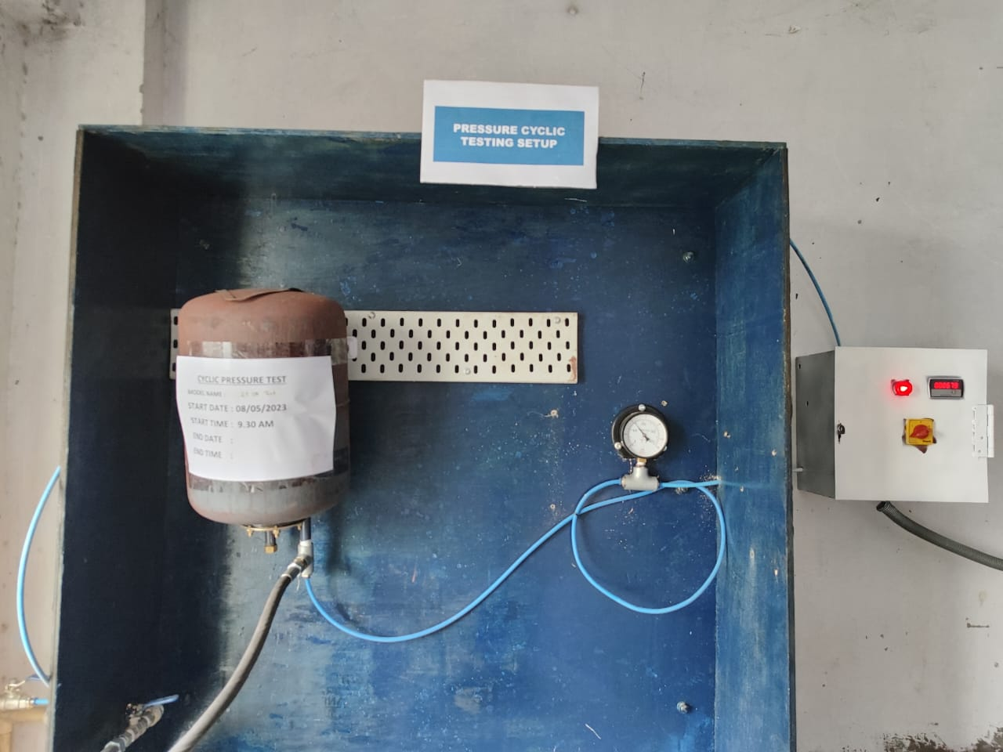
COMPANY LAYOUT
LAB ENDURANCE ROOM
CYCLIC PRESSURE TEST

Slide 10
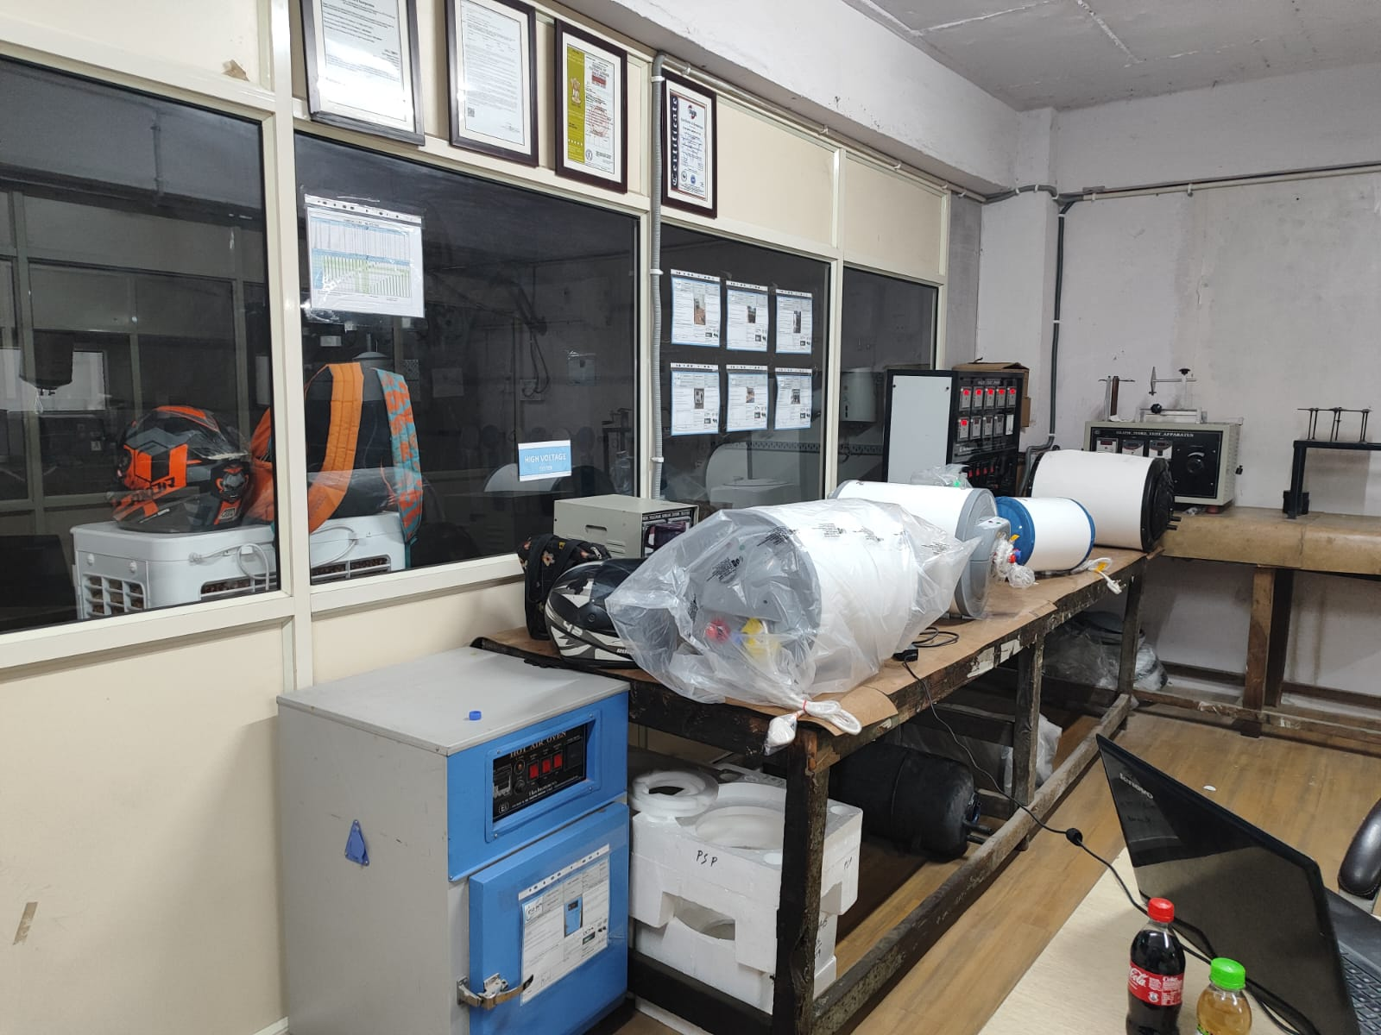
COMPANY LAYOUT
LAB TESTING
TESTING EQUIPMENTS
HUMIDITY CHAMBER
HOT AIR OVEN
MULTI TESTING PANEL
GLOW WIRE TEST APPRATUS
TEMP. RISE
IMPACT TESTER
TORQUE WRENCH
PULL LOAD TEST
ENDURANCE
H.V TESTER
MILI OHM METER
CYCLIC PRESSURE
AUTOMATIC STANDING LOSS

